Slide 1

BLACKTECH HOTEL QUARTER ONE REPORT
PRESENTED BY ESTHER OLUFUNTO EBERE

Slide 2
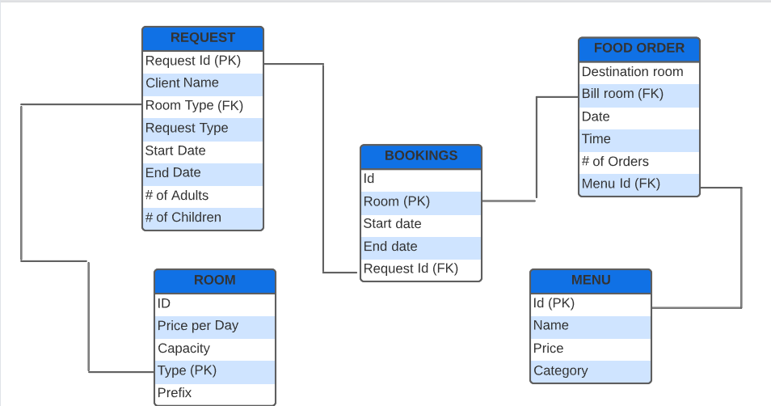
Entity Relationship Diagram (ERD) for Blacktech Hotel
Notes:
Entities include: Room, Request, Bookings, Food Order, Menu Attributes are displayed in each Entities

Slide 3
Description of ERD for Blacktech Hotel
The attributes of Blacktech hotel are stored into their respective entities.
Each entity (Room, Request, Bookings, Menu) contains primary keys.
There is a many-to-many relationship between Request and Food Order. There is also a one-to-many relationship between Room and Food Order .
There is a one-to-many relationship between Request and Booking, while Booking and Request has a one-to-one relationship.

Slide 4
Data Quality Issues
There is a date inconsistency (year = 1916) in the Bookings table as seen in Request ID numbers 938,3101 and 4604.
The number of guests is more than the room capacity of the hotel.
There is absence of primary key in the food order table, which made establishing a relationship challenging.
Bookings and Request dates are overlapping, which made distinguishing customers who follow through with their booking challenging.
The data provided is for a three month period, which does not give the full financial picture of Blacktech Hotel.
There is a request type for Vacation and Holiday, which serves the same purpose, therefore implies a redundancy.
Booking room is not uniquely identified.
Multiple guest profile: there is no major distinction for the hotel to use data from guest profiles to deliver highly personalized customer experience.

Slide 5
Data Quality Recommendations
Blacktech hotel needs to adopt different IT systems to manage entity relationships/guest interactions, i.e. upgrade or change the hotel’s database to explicitly distinguish the entities.
Ensure data collected in the new system is secure, clean and more distinct.
There should be explicit separation between booking and request entities in order to distinguish clients who requested and followed through with booking from clients who just requested.
Data collection should be automated and not manually collected in order to reduce or cancel out multiple guest profiles; for example, a unique identification key can be provided for loyal/returning guests.
The software development team can ensure the creation of customer feedback system. This would assist in understanding why customer requested and did not follow through with the booking.

Slide 6
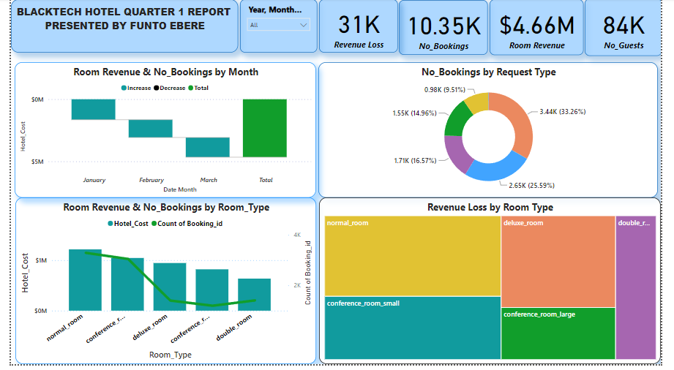

Slide 7
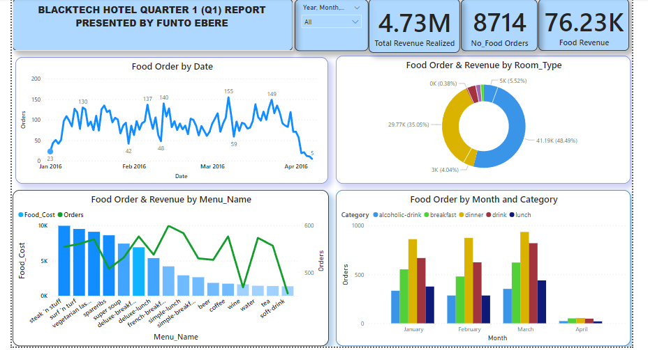

Slide 8
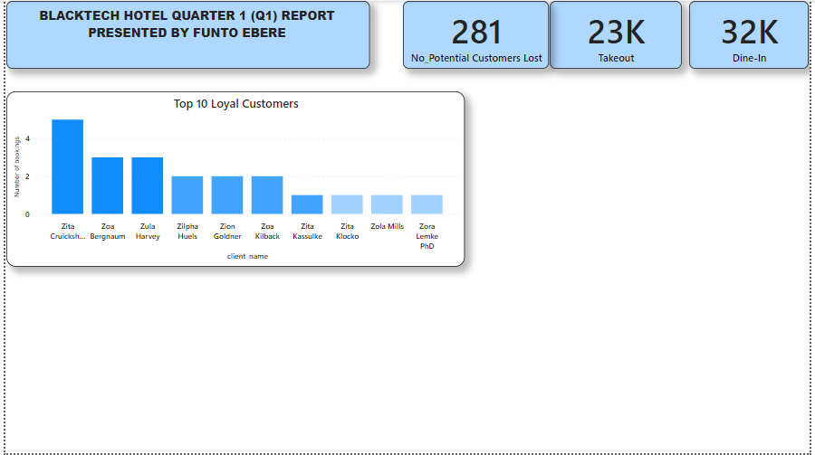

Slide 9
Food Order Menu Analysis
Food Order by Date
Consistent fluctuation of food orders occurred daily and monthly throughout the quarter.
Food Order and Revenue by Menu_Name
Steak N stuff takes the lead in menu, surf n turf is second highest, while tea and soft drinks are least on the list.
The more menu orders available, the more food revenue Blacktech hotel has.
Food Order and Revenue by Room Type
Conference room largely makes up 48.49% of revenue plus 5.52% in food order.
Double room makes up 1.2% of revenue.
Food Order by Month and Food Category
It is observed that Dinner was in high demand in Q1, followed by Drinks.
The least category is alcoholic drinks for all months, except in February, where there is a tie with lunch.

Slide 10
Room/Request/Bookings Analysis
Room Revenue and Number of Bookings per Month
January had the highest number of bookings and the room revenue, while February had the lowest room revenue and booking count.
Number of Bookings by Request Type
Holidays make up 33.26% of the reason for bookings, business is the 2nd highest reason with 25.59%, while conference makes the least percentage of 9.51% of booking number.
Loyal Customers
A sample of 10 clients was taken. It is observed that a certain number of clients frequently booked with Zita Cruickshank taking the lead, followed by Zoa Bergnaum.
Revenue Loss by Room Type
Over $30,000 was lost in potential bookings.
Normal Room had the highest revenue loss ($15,440), while double room had the least revenue loss($6,300)
The Normal room has the highest amount of loss as capacity did not match customer’s request.
Room Revenue and Number of Bookings by Room Type
The month of January accounted for the highest revenue in terms of room bookings.
Normal room makes up 31.83% of the Hotel revenue, while the double room type makes up 13.60% of the hotel revenue.
The Vacation request type has the lowest booking number, while the holiday has the highest booking number.
Over 200 customers did not complete room booking.

Slide 11
Recommendation on Design Transformation
Focus on the room types that generate more revenue by making it more attractive, while trying to improve services with room types that do not generate enough.
The vacation and holiday request types should be merged into a single request type to avoid wrong analysis.
Incentives for returning /loyal customers should include points that can be redeemed into gift cards or purchase menu items at the restaurant.
Another incentive for loyal clients would be discounts on special occasions or holidays.
Incentives should be created to encourage guests to eat in restaurants- such as Jazz music or live performances. This will create more revenue.

Slide 12

THANK YOU

Slide 13
QUESTIONS & COMMENTS?

